Slide 1
Unit 3. Generative Grammars

Slide 2
Basic concepts of languages theory
Parsing or syntactic analysis is the process of analyzing a string of symbols, either in natural languages or in computer languages, conforming to the rules of a formal grammar.
The formal language theory considers a language as a mathematical object.
A language is just a set of strings (sentences). To formally define a language we need to formally define what are the strings admitted by the language.

Slide 3
Alphabet
Symbol
A physical entity that we shall not formally define; we shall rely on intuition.
Alphabet
A finite, non-empty set of symbols
We often use the symbol ∑ (sigma) to denote an alphabet
Examples of alphabet
Binary: ∑ = {0,1}
All lower case letters: ∑ = {a,b,c,..z}
Alphanumeric: ∑ = {a-z, A-Z, 0-9}
DNA molecule letters: ∑ = {a,c,g,t}(guanine, adenine, thymine, and cytosine)
C character set
KPL token set.

Slide 4
C character set
Types | Character Set
Lowercase Letters | a –z
Uppercase Letters | A - Z
Digits | 0-9
Special Characters | ~! # $% ^ & *( )_ +| \’ - = { } [] : ” ; < > ? , . /
White Spaces | Tab Or New line Or Space

Slide 5
Token set of KPL
Identifiers, numbers, character constants
Keywords
PROGRAM, CONST, TYPE, VAR, PROCEDURE, FUNCTION, BEGIN, END, ARRAY, OF, INTEGER, CHAR, CALL, IF, ELSE, WHILE, DO, FOR, TO
Operators
:= (assign), + (addition), - (subtraction), * (multiplication), / (division), = (comparison of equality), != (comparison of difference), > (comparison of greaterness), < (comparison of lessness), >= (comparison of greaterness or equality), <= (comparison of lessness or equality)
Separators:
:,;,(,),,,(.,.),.

Slide 6
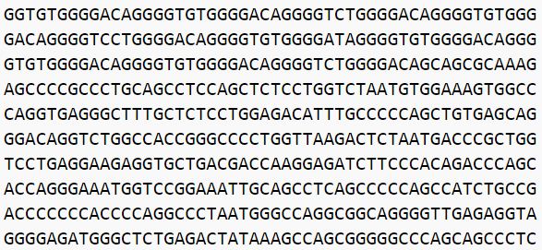
String (sentence)
A string is finite sequence of symbols chosen from some alphabet
Empty string is ε
Examples of string:
1000010101111
A C program is a string of tokens
A human DNA pattern

Slide 7
Languages
A language over alphabet Σ is a set of
strings over Σ
Examples of languages:
The set of all words over {a, b},
The set { a^{n} | n is a prime number },
Programming language C: the set of syntactically correct programs in C

Slide 8
Chomsky's Hierarchy
Type-0 languages (recursive enumerable)
instances of a problem.
Type-1 languages (context-sensitive)
natural languages, DNA languages
Type-2 languages (context-free)
programming language, natural languages
Type-3 languages (regular)
tokens of programming languages
Notes:
There are linguistics structures (such as cross-serial dependency) that are not naturally expressed with CF languages. Thus scientists have been defining more powerful syntactics formalisms, such as tree-adjoining grammar (TAG)
For example TAGs and equivalent formalism have been considered in biology the explain DNA structures related to specific types offolding of DNA or RNA strands.

Slide 9
A grammar to generate real numbers
<real number> ::= <sign><natural number> |
<sign><natural number>'.'<digit sequence> | <sign>'.'<digit><digit sequence> |
<sign><real number>'e'<natural number>
<sign> ::= ‘’ | ‘+’ | ‘-‘
<natural number> ::= ‘0’ | <nonzero digit><digit sequence>
<nonzero digit> ::= ‘1’ | ‘2’ | ‘3’ | ‘4’ | ‘5’ | ‘6’ | ‘7’ | ‘8’ | ‘9’
<digit sequence> ::= ‘’ | <digit><digit sequence>
<digit> ::= ‘0’ | ‘1’ | ‘2’ | ‘3’ | ‘4’ | ‘5’ | ‘6’ | ‘7’ | ‘8’ | ‘9’

Slide 10
How a string of a context free language can be generate ?
A context free grammar can be used to generate strings in the corresponding language as follows:
let X = the start symbol s
while there is some nonterminal Y in X do
apply any one production rule using Y, e.g.
Y -> w

Slide 11
Context Free Grammars (CFG)
A context free grammar G has:
A set of terminal symbols, Σ
A set of nonterminal symbols, Δ
A start symbol, S, which is a member of Δ
A set P of production rules of the form A -> w, where A is a nonterminal and w is a string of terminal and nonterminal symbols or ε.

Slide 12
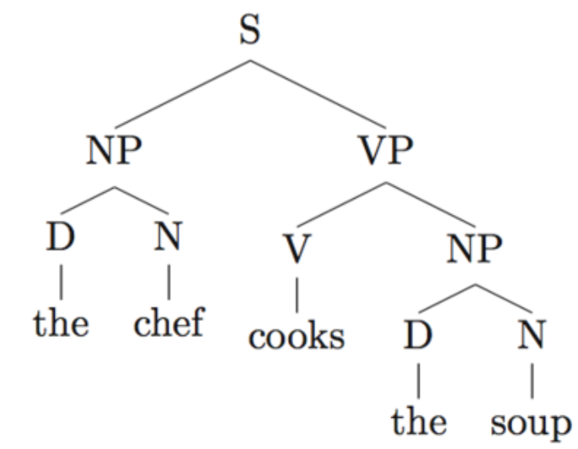
Parse Tree
S → NP VP
NP → D N
VP → V NP
D → the
N → chef
N → soup
V → soup

Slide 13
Context Free Grammar Examples
Grammar of nested parentheses G = (Σ, Δ, P, S) where
Δ = {S}
Σ ={ (, ) }
P ={ S→ (S), S→SS, S→ε }

Slide 14
Context Free Grammar Examples
The grammar of decimal numbers
S -> +A | -A | A
A -> B.B | B
B -> BC | C
C -> 0 | 1 | 2 |. . . .| 9

Slide 15
Derivations
When X consists only of terminal symbols, it is a string of the language denoted by the grammar.
Each iteration of the loop is a derivation step.
If an iteration has several nonterminals to choose from at some point, the rules of derviation would allow any of these to be applied.
Example : S ⇨ -A ⇨ -B.B ⇨ -B.C ⇨ -C.C ⇨-1.C ⇨ -1.5

Slide 16
Leftmost and Rightmost Derivations
In practice, parsing algorithms tend to always choose the leftmost nonterminal, or the rightmost nonterminal, resulting in strings that are leftmost derivations or rightmost derivations
Example:
Leftmost derivation:
S ⇨ -A ⇨ -B.B ⇨ -C.B ⇨ -1.B ⇨ -1.C ⇨ -1.5
Rightmost derivation:
S ⇨ -A ⇨ -B.B ⇨ -B.C ⇨ -B.5 ⇨ -C.5 ⇨ -1.5

Slide 17
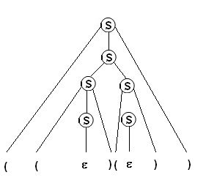
Derivation Tree (parse tree)
Derivation tree is constructed with
1) Each tree vertex is a variable (nonterminal) or terminal or epsilon
2) The root vertex is S
3) Interior vertices are from Δ, leaf vertices are from ∑ or epsilon
4) An interior vertex A has children, in order, left to right,
X₁, X₂, ... , X_{k} when there is a production in P of the
form A -> X₁ X₂ ... X_{k}
5) A leaf can be epsilon only when there is a production A → ε and the leaf’s parent can have only this child.

Slide 18
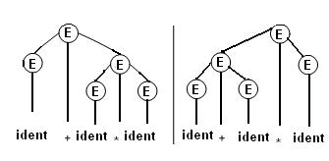
Ambiguity
Grammar
E -> E + E
E -> E * E
E -> ( E )
E -> ident
allows two different derivations for strings such as ident + ident * ident (e.g. x + y * z)
The grammar is ambiguous

Slide 19
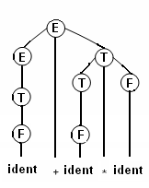
Disambiguation
E -> E + T
E -> T
T -> T * F
T -> F
F -> ( E )
F -> ident
(by adding some nonterminals and production rules to force operator precedence)

Slide 20
Recursion
A production is recursive if X ⇒* ω1X ω2 Can be used to represent repetitions and nested structures
Direct recursion X ⇒ω₁X ω₂
Left recursion X -> b | Xa. X ⇒X a ⇒X a a ⇒X a a a ⇒b a a a a a ... Right recursion X -> b | a X. X ⇒a X ⇒a a X ⇒a a a X ⇒... a a a a a b Central recursion X ->b | ( X). X ⇒(X) ⇒((X)) ⇒(((X))) ⇒(((... (b)...)))
Indirect recursion X ⇒* ω₁X ω₂ Example

Slide 21
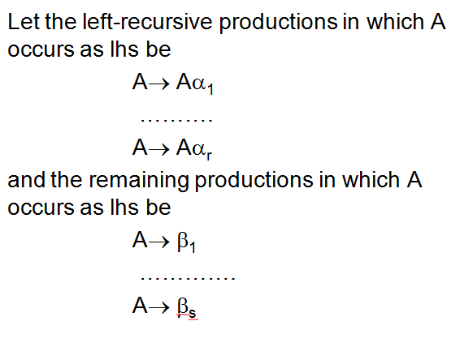
Removing Left Recursion

Slide 22
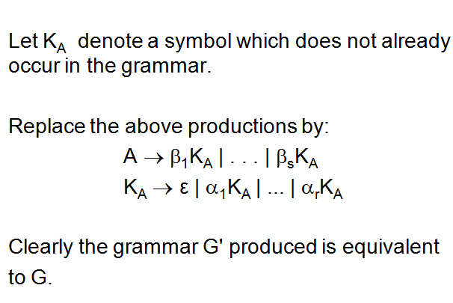
Removing Left Recursion

